Slide 1
Using the Dependency Tracking Utility
You can execute the DEPTREE_FILL() procedure for any database object you wish to test.
It fills the IDEPTREE utility table
It reports all database objects which are dependent upon the specified object.
It requires 3 parameters
Object Type
Object Owner
Object Name

Slide 2
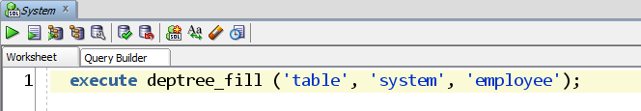
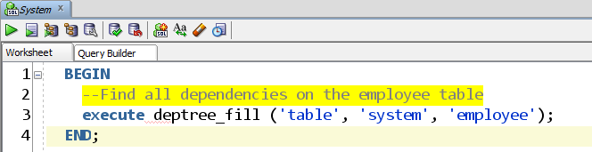
Execute Dependency Tracking Utility
This same operation can be performed within an anonymous block.
Owner is SYSTEM
Object type is TABLE
Object Name is EMPLOYEE

Slide 3
Dependency Tracking Results
When the Dependency Tracking Utility completes, the ideptree table contains the results.
It is up to you to either open the table or query the results.
SQL> SELECT * FROM ideptree;
DEPENDENCIES
---------------------------------------------------------------
PROCEDURE SYSTEM.RAISE_SALARY_VALID
PROCEDURE SYSTEM.RAISE_SALARY
TABLE SYSTEM.EMPLOYEE

Slide 4
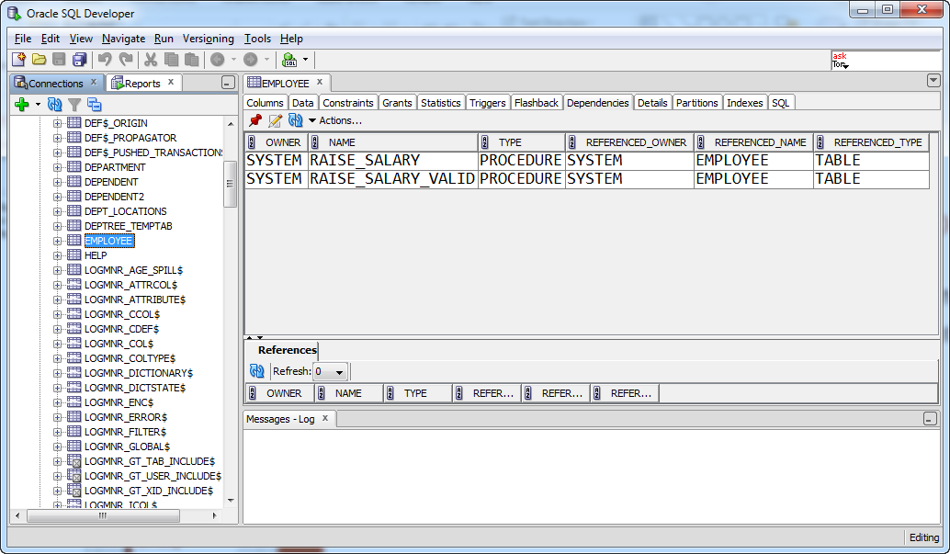
Track Dependencies in SQL Developer
The SQL Developer interface includes a Dependencies tab for any database-resident program component.

Slide 5

See It In Action

